Slide 1
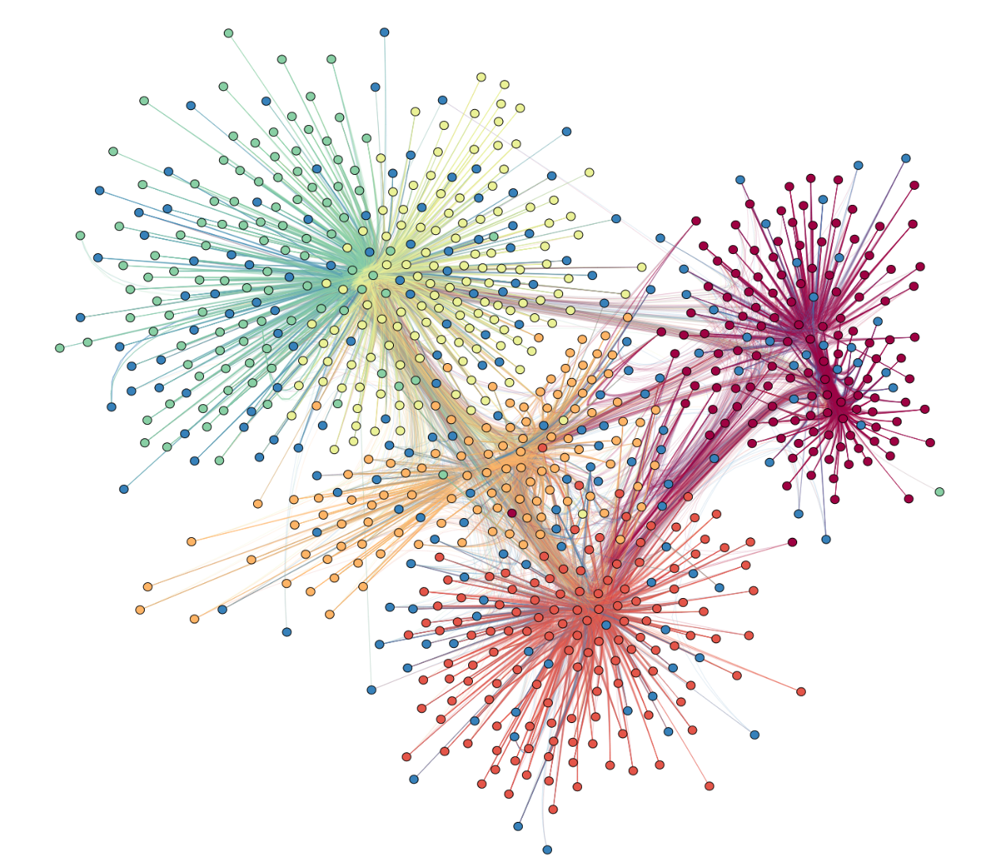

Clustering Methods
Hierarchical Clustering
$k$-Means
Notes:
http://vidi.cs.ucdavis.edu/projects/AggressionNetworks/

Slide 2
Hierarchical Clustering
Subsequent steps: Merge the two closets clusters.
A B C
D E
A B
A
B
C
D
E
Initial step: Each object is assigned to its own cluster.

Slide 3
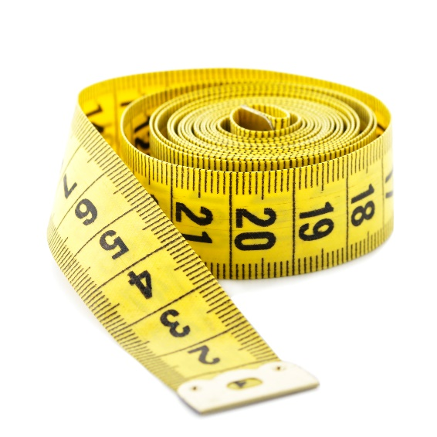

Hierarchical Clustering
How do we measure distance from one cluster to another?
How do we know when to stop?
Notes:
http://www.clipartpanda.com/categories/stop-sign-clip-art-Microsoft

Slide 4

Dendrogram
4
3
Distance
2
1
0
A
B
C
D
E
F
G
Observations

Slide 5
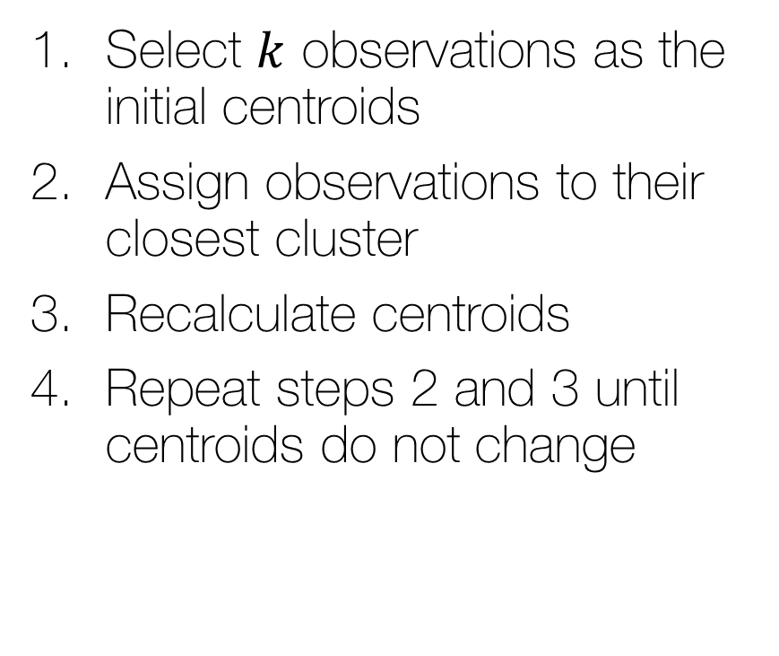
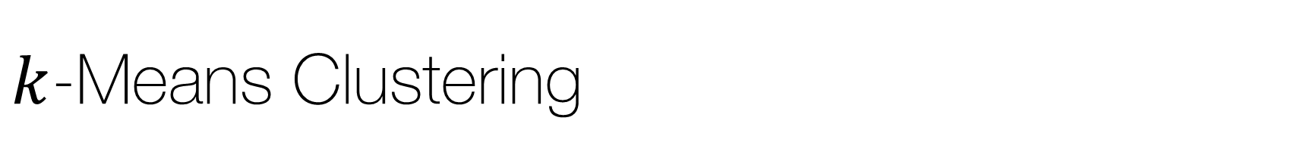
$k$-Means Clustering
Select $k$ observations as the initial centroids
Assign observations to their closest cluster
Recalculate centroids
Repeat steps 2 and 3 until centroids do not change
*
*

Slide 6

Data for $k$-Means Example
Name | Age | Income
Ann | 35 | 90000
Bob | 29 | 135000
Clara | 65 | 95000
David | 22 | 50000
Erin | 49 | 114000
Frank | 57 | 150000
George | 25 | 120000

Slide 10
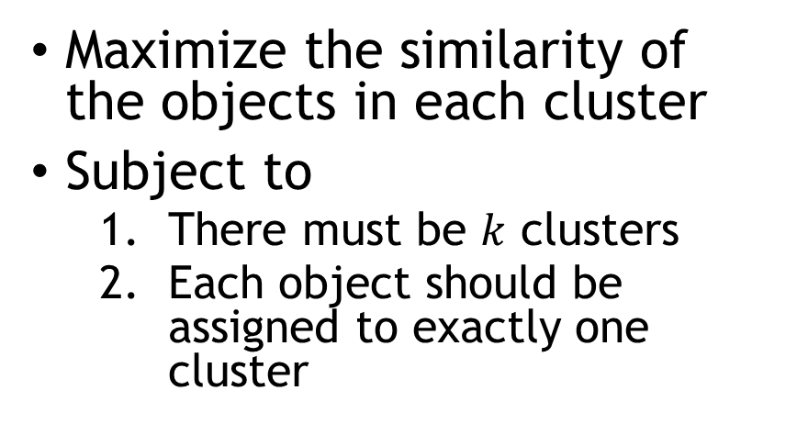
Clustering as an Optimization Problem
Maximize the similarity of the objects in each cluster
Subject to
There must be $k$ clusters
Each object should be assigned to exactly one cluster

